Slide 1

COURSE SLIDES
Certified Lean Six Sigma Yellow Belt (CLSSYB) Training
WSQ Course Code: TGS-2025053922
Conducted by Tertiary Infotech Academy Pte Ltd
Version 2
Certified Lean Six Sigma Yellow Belt (CLSSYB) Training - TGS-2025053922
(c) 2026 Tertiary Infotech Academy Pte Ltd
1

Slide 2
COURSE ADMINISTRATION
Welcome & Housekeeping
1
Set your mobile phone to silent mode.
2
Participate actively - no question is too small.
3
Mutual respect: agree to disagree.
4
One conversation at a time.
5
Be punctual; return from breaks on time.
6
75% attendance is required.
Certified Lean Six Sigma Yellow Belt (CLSSYB) Training - TGS-2025053922
(c) 2026 Tertiary Infotech Academy Pte Ltd
2

Slide 3
YOUR TRAINER - GENERAL
About the Trainer
NAME
?
TITLE / DESIGNATION
QUALIFICATIONS
Your Trainer
AREAS OF EXPERTISE
General Trainer template - to be completed by the trainer
TRAINING & INDUSTRY EXPERIENCE
CONTACT
Certified Lean Six Sigma Yellow Belt (CLSSYB) Training - TGS-2025053922
(c) 2026 Tertiary Infotech Academy Pte Ltd
3

Slide 4
ADMIN
Digital Attendance
AM, PM and assessment attendance are mandatory.
Scan the SSG digital attendance QR code when shown.
Minimum 75% attendance is required for assessment and funding.
Certified Lean Six Sigma Yellow Belt (CLSSYB) Training - TGS-2025053922
(c) 2026 Tertiary Infotech Academy Pte Ltd
4

Slide 5
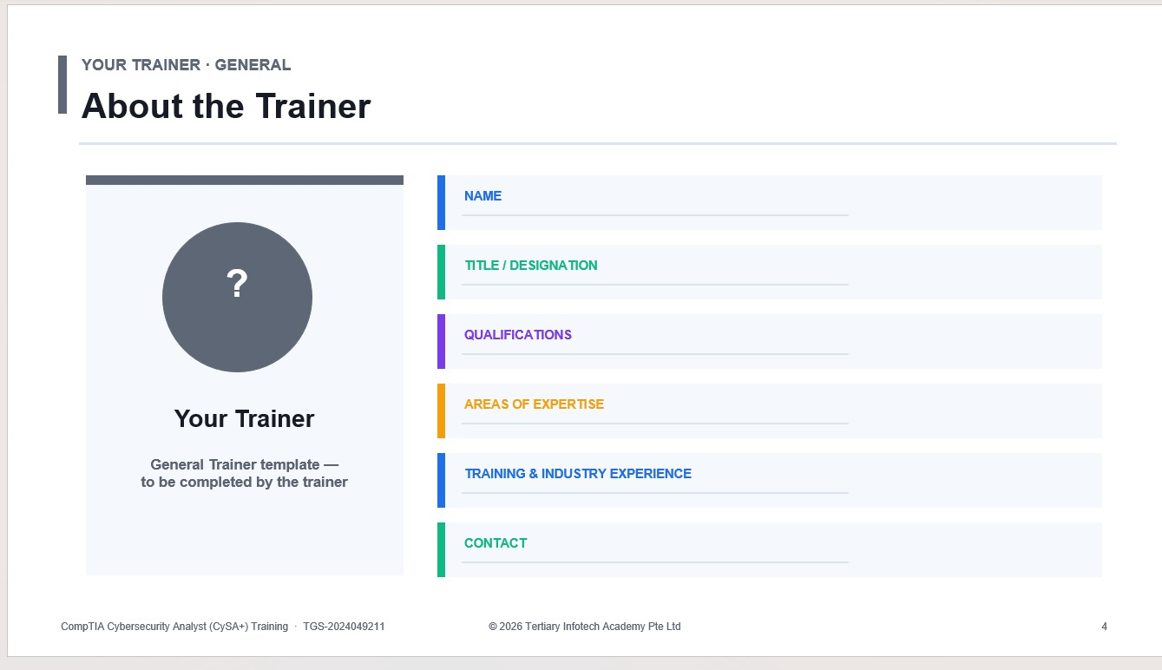

Slide 6
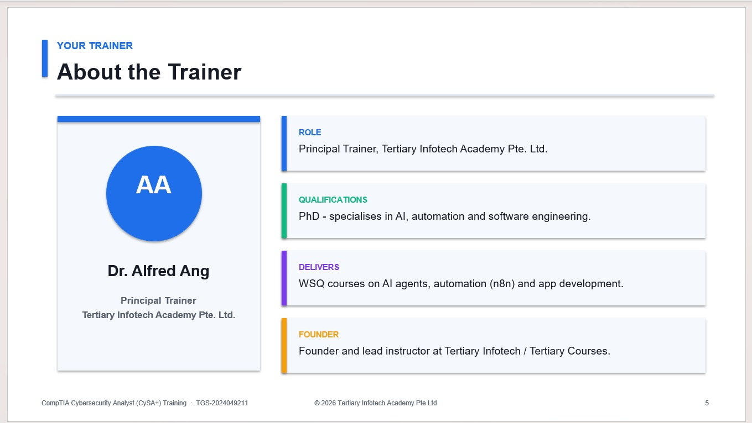

Slide 7
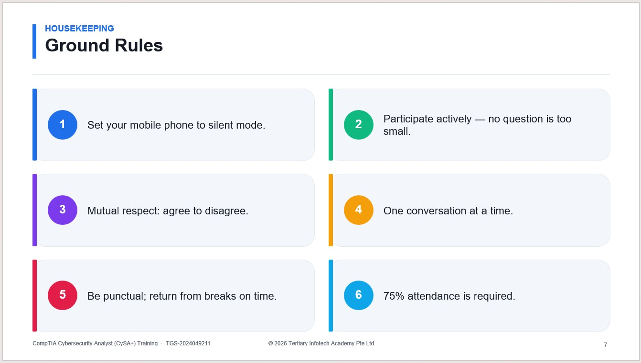

Slide 8
ADMIN
Course Objectives
Build a Yellow Belt improvement package for Contoso Service Desk.
Practise Lean Six Sigma tools through ten aligned labs.
Prepare for assessment and certification readiness.
Certified Lean Six Sigma Yellow Belt (CLSSYB) Training - TGS-2025053922
(c) 2026 Tertiary Infotech Academy Pte Ltd
8

Slide 9
ADMIN
Learning Outcomes
Explain Yellow Belt support responsibilities.
Identify customer value, waste, defects and variation.
Use SIPOC, PDCA and DMAIC Define tools.
Plan data collection and perform basic analysis.
Support root cause, countermeasures and control planning.
Certified Lean Six Sigma Yellow Belt (CLSSYB) Training - TGS-2025053922
(c) 2026 Tertiary Infotech Academy Pte Ltd
9

Slide 10
ADMIN
Course Roadmap
Role
Value
Map
Define
Measure
Analyze
Improve
Control
Certified Lean Six Sigma Yellow Belt (CLSSYB) Training - TGS-2025053922
(c) 2026 Tertiary Infotech Academy Pte Ltd
10

Slide 11
ADMIN
Assessment
Final assessment starts Day 2 at 4:00 PM.
Assessment is completed on the LMS.
Learners should use their lab outputs and guide for revision.
Certified Lean Six Sigma Yellow Belt (CLSSYB) Training - TGS-2025053922
(c) 2026 Tertiary Infotech Academy Pte Ltd
11

Slide 12
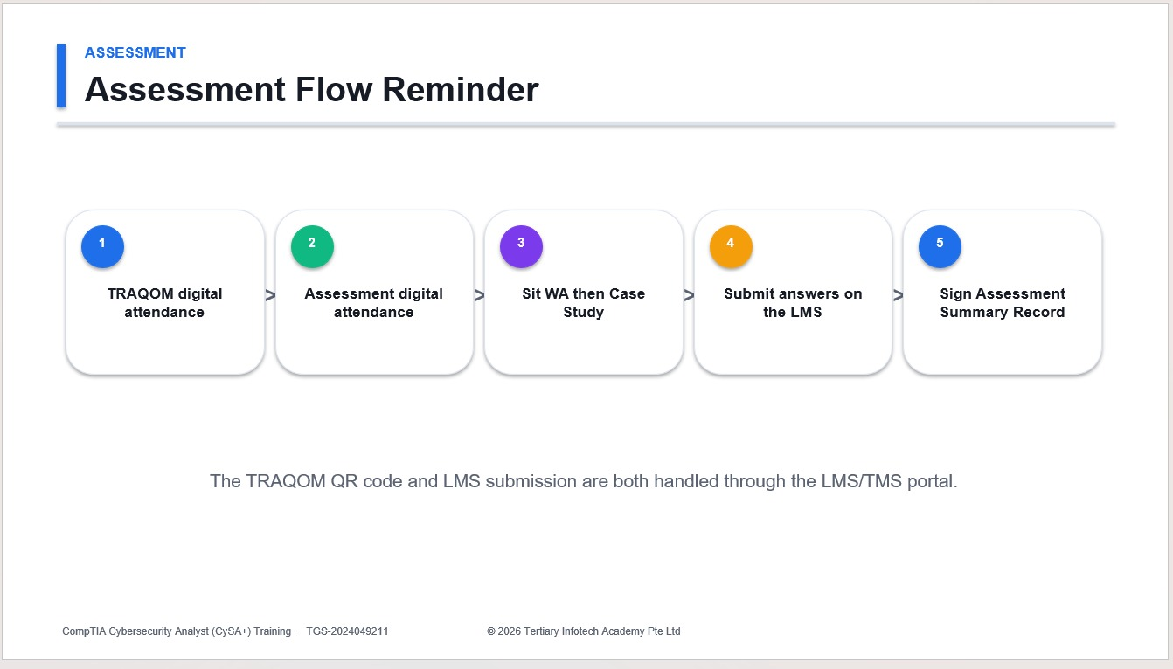

Slide 13
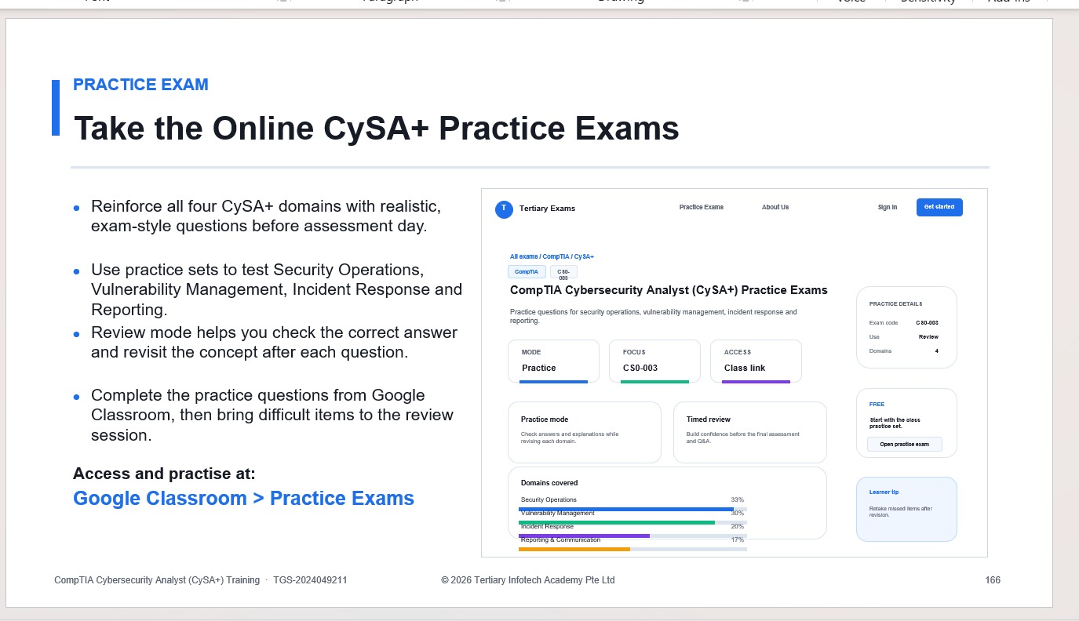

Slide 14
ADMIN
Certification and TRAQOM Survey
Complete certification and TRAQOM survey.
Confirm digital attendance records.
Keep the completed improvement package for workplace reference.
Certified Lean Six Sigma Yellow Belt (CLSSYB) Training - TGS-2025053922
(c) 2026 Tertiary Infotech Academy Pte Ltd
14

Slide 15
SLIDE 15 - LAB OVERVIEW
Lab 1: Yellow Belt Role, Certification Paths, and Improvement Scenario
Explain the Lean Six Sigma Yellow Belt role, compare certification path expectations, and choose a simple improvement scenario.
Contoso Service Desk wants to reduce delays in assigning support tickets. You are not leading a major Green Belt project, but you are supporting the team by mapping the process, gathering data, and testing a small PDCA improvement.
Primary skill: Yellow Belt role and readiness
Deliverable: Submit role table, certification path comparison, selected scenario, and readiness checklist.
Certified Lean Six Sigma Yellow Belt (CLSSYB) Training - TGS-2025053922
(c) 2026 Tertiary Infotech Academy Pte Ltd
15

Slide 16
SLIDE 16 - LAB GUIDE
Lab 1: Step-by-step work
Learner actions
Evidence to submit
- Step 1 - Define the Yellow Belt role
- Step 2 - Compare certification pathways
- Step 3 - Select improvement scenario
- Step 4 - Create readiness checklist
- Submit role table, certification path comparison,
- selected scenario, and readiness checklist.
Certified Lean Six Sigma Yellow Belt (CLSSYB) Training - TGS-2025053922
(c) 2026 Tertiary Infotech Academy Pte Ltd
16

Slide 17
SLIDE 17 - REVIEW
Lab 1: Checkpoint
Why does a Yellow Belt usually support rather than lead major projects?
Why is process mapping an important Yellow Belt contribution?
What makes your chosen scenario suitable for a small improvement?
Certified Lean Six Sigma Yellow Belt (CLSSYB) Training - TGS-2025053922
(c) 2026 Tertiary Infotech Academy Pte Ltd
17

Slide 18
SLIDE 18 - DEBRIEF
Lab 1: Trainer debrief
What changed in the Contoso improvement package?
Which template or table was completed?
What evidence supports the next lab?
Certified Lean Six Sigma Yellow Belt (CLSSYB) Training - TGS-2025053922
(c) 2026 Tertiary Infotech Academy Pte Ltd
18

Slide 19
SLIDE 19 - LAB OVERVIEW
Lab 2: Lean, Six Sigma, Waste, Voice of Customer, and Value
Identify customer value, voice of customer, waste, defects, and variation in a simple process.
Employees complain that IT support tickets are slow and status updates are unclear. The team needs to understand what customers value before choosing improvements.
Primary skill: Lean Six Sigma foundations
Deliverable: Submit VOC table, value-added table, waste walk table, and defect/variation notes.
Certified Lean Six Sigma Yellow Belt (CLSSYB) Training - TGS-2025053922
(c) 2026 Tertiary Infotech Academy Pte Ltd
19

Slide 20
SLIDE 20 - LAB GUIDE
Lab 2: Step-by-step work
Learner actions
Evidence to submit
- Step 1 - Capture voice of customer
- Step 2 - Identify value-added work
- Step 3 - Conduct a waste walk
- Step 4 - Connect Six Sigma to defects and variation
- Submit VOC table, value-added table, waste walk
- table, and defect/variation notes.
Certified Lean Six Sigma Yellow Belt (CLSSYB) Training - TGS-2025053922
(c) 2026 Tertiary Infotech Academy Pte Ltd
20

Slide 21
SLIDE 21 - REVIEW
Lab 2: Checkpoint
What is the difference between waste and a defect?
Why should customer needs be translated into CTQs?
Which waste appears most often in your scenario?
Certified Lean Six Sigma Yellow Belt (CLSSYB) Training - TGS-2025053922
(c) 2026 Tertiary Infotech Academy Pte Ltd
21

Slide 22
SLIDE 22 - DEBRIEF
Lab 2: Trainer debrief
What changed in the Contoso improvement package?
Which template or table was completed?
What evidence supports the next lab?
Certified Lean Six Sigma Yellow Belt (CLSSYB) Training - TGS-2025053922
(c) 2026 Tertiary Infotech Academy Pte Ltd
22

Slide 23
SLIDE 23 - LAB OVERVIEW
Lab 3: SIPOC, Process Mapping, Handoffs, and Yellow Belt SME Support
Create a SIPOC and process map that helps an improvement team understand boundaries, handoffs, inputs, outputs, and customers.
The service desk manager asks you to map the ticket assignment process so a Green Belt can decide whether a larger DMAIC project is needed.
Primary skill: SIPOC and process mapping
Deliverable: Submit SIPOC, detailed process map, pain point notes, and SME notes.
Certified Lean Six Sigma Yellow Belt (CLSSYB) Training - TGS-2025053922
(c) 2026 Tertiary Infotech Academy Pte Ltd
23

Slide 24
SLIDE 24 - LAB GUIDE
Lab 3: Step-by-step work
Learner actions
Evidence to submit
- Step 1 - Build SIPOC
- Step 2 - Create detailed process map
- Step 3 - Mark pain points
- Step 4 - Prepare SME notes
- Submit SIPOC, detailed process map, pain point
- notes, and SME notes.
Certified Lean Six Sigma Yellow Belt (CLSSYB) Training - TGS-2025053922
(c) 2026 Tertiary Infotech Academy Pte Ltd
24

Slide 25
SLIDE 25 - REVIEW
Lab 3: Checkpoint
Why is SIPOC useful before detailed mapping?
What is a handoff risk?
How can a Yellow Belt help a project leader without owning the whole project?
Certified Lean Six Sigma Yellow Belt (CLSSYB) Training - TGS-2025053922
(c) 2026 Tertiary Infotech Academy Pte Ltd
25

Slide 26
SLIDE 26 - DIAGRAM
SIPOC turns a process into a shared map
Supplier
Input
Process
Output
Customer
Certified Lean Six Sigma Yellow Belt (CLSSYB) Training - TGS-2025053922
(c) 2026 Tertiary Infotech Academy Pte Ltd
26

Slide 27
SLIDE 27 - LAB OVERVIEW
Lab 4: PDCA Small Improvement Project Charter
Create a PDCA charter for a small improvement that a Yellow Belt could support or run under guidance.
The service desk wants to test whether a new ticket triage checklist reduces assignment delay within two weeks.
Primary skill: PDCA project charter
Deliverable: Submit PDCA table, problem statement, goal statement, scope, risk table, and test plan.
Certified Lean Six Sigma Yellow Belt (CLSSYB) Training - TGS-2025053922
(c) 2026 Tertiary Infotech Academy Pte Ltd
27

Slide 28
SLIDE 28 - LAB GUIDE
Lab 4: Step-by-step work
Learner actions
Evidence to submit
- Step 1 - Define PDCA cycle
- Step 2 - Write problem and goal statements
- Step 3 - Define scope
- Step 4 - Identify risks and assumptions
- Submit PDCA table, problem statement, goal
- statement, scope, risk table, and test plan.
Certified Lean Six Sigma Yellow Belt (CLSSYB) Training - TGS-2025053922
(c) 2026 Tertiary Infotech Academy Pte Ltd
28

Slide 29
SLIDE 29 - REVIEW
Lab 4: Checkpoint
Why is PDCA suitable for small improvements?
What makes a goal statement measurable?
What decision will you make after the Check phase?
Certified Lean Six Sigma Yellow Belt (CLSSYB) Training - TGS-2025053922
(c) 2026 Tertiary Infotech Academy Pte Ltd
29

Slide 30
SLIDE 30 - DIAGRAM
PDCA keeps small improvements controlled
Plan
Do
Check
Act
Certified Lean Six Sigma Yellow Belt (CLSSYB) Training - TGS-2025053922
(c) 2026 Tertiary Infotech Academy Pte Ltd
30

Slide 31
SLIDE 31 - LAB OVERVIEW
Lab 5: DMAIC Overview, Problem Statement, Scope, and Stakeholders
Support the Define phase of a DMAIC project by clarifying the problem, scope, stakeholders, customers, and expected benefits.
The PDCA pilot shows promise, but management may escalate the issue to a larger DMAIC project. Your Yellow Belt task is to prepare clear Define information.
Primary skill: DMAIC Define support
Deliverable: Submit DMAIC summary, refined problem statement, stakeholder table, project boundaries, and benefit notes.
Certified Lean Six Sigma Yellow Belt (CLSSYB) Training - TGS-2025053922
(c) 2026 Tertiary Infotech Academy Pte Ltd
31

Slide 32
SLIDE 32 - LAB GUIDE
Lab 5: Step-by-step work
Learner actions
Evidence to submit
- Step 1 - Summarize DMAIC
- Step 2 - Refine problem statement
- Step 3 - Identify stakeholders
- Step 4 - Define project boundaries
- Submit DMAIC summary, refined problem statement,
- stakeholder table, project boundaries, and benefit
- notes.
Certified Lean Six Sigma Yellow Belt (CLSSYB) Training - TGS-2025053922
(c) 2026 Tertiary Infotech Academy Pte Ltd
32

Slide 33
SLIDE 33 - REVIEW
Lab 5: Checkpoint
Why should a problem statement avoid naming a solution?
Which DMAIC phases can a Yellow Belt support strongly?
Who must be involved before scope is finalized?
Certified Lean Six Sigma Yellow Belt (CLSSYB) Training - TGS-2025053922
(c) 2026 Tertiary Infotech Academy Pte Ltd
33

Slide 34
SLIDE 34 - DIAGRAM
DMAIC gives the project a disciplined path
Define
Measure
Analyze
Improve
Control
Certified Lean Six Sigma Yellow Belt (CLSSYB) Training - TGS-2025053922
(c) 2026 Tertiary Infotech Academy Pte Ltd
34

Slide 35
SLIDE 35 - LAB OVERVIEW
Lab 6: Data Collection, KPIs, Check Sheets, and Basic Metrics
Create a data collection plan with KPIs, operational definitions, check sheets, and basic metric calculations.
The service desk team has anecdotal complaints, but improvement decisions need data. You will design a simple measurement plan.
Primary skill: Measurement planning
Deliverable: Submit KPI table, check sheet, defect categories, sampling plan, and basic metric calculations.
Certified Lean Six Sigma Yellow Belt (CLSSYB) Training - TGS-2025053922
(c) 2026 Tertiary Infotech Academy Pte Ltd
35

Slide 36
SLIDE 36 - LAB GUIDE
Lab 6: Step-by-step work
Learner actions
Evidence to submit
- Step 1 - Define KPIs
- Step 2 - Create a check sheet
- Step 3 - Define defect categories
- Step 4 - Plan sampling
- Submit KPI table, check sheet, defect categories,
- sampling plan, and basic metric calculations.
Certified Lean Six Sigma Yellow Belt (CLSSYB) Training - TGS-2025053922
(c) 2026 Tertiary Infotech Academy Pte Ltd
36

Slide 37
SLIDE 37 - REVIEW
Lab 6: Checkpoint
Why does an operational definition matter?
What bias could affect your data?
Which KPI best reflects the customer pain point?
Certified Lean Six Sigma Yellow Belt (CLSSYB) Training - TGS-2025053922
(c) 2026 Tertiary Infotech Academy Pte Ltd
37

Slide 38
SLIDE 38 - DEBRIEF
Lab 6: Trainer debrief
What changed in the Contoso improvement package?
Which template or table was completed?
What evidence supports the next lab?
Certified Lean Six Sigma Yellow Belt (CLSSYB) Training - TGS-2025053922
(c) 2026 Tertiary Infotech Academy Pte Ltd
38

Slide 39
SLIDE 39 - LAB OVERVIEW
Lab 7: Pareto, Run Charts, Variation, Yield, DPU, and DPMO
Analyze simple process data using Pareto charts, run charts, variation concepts, yield, DPU, and DPMO.
You collected two weeks of service desk data. The team wants to know which defect category matters most and whether assignment time is improving.
Primary skill: Basic analysis and variation
Deliverable: Submit Pareto table, chart screenshot or notes, run chart, metric calculations, and interpretation notes.
Certified Lean Six Sigma Yellow Belt (CLSSYB) Training - TGS-2025053922
(c) 2026 Tertiary Infotech Academy Pte Ltd
39

Slide 40
SLIDE 40 - LAB GUIDE
Lab 7: Step-by-step work
Learner actions
Evidence to submit
- Step 1 - Build Pareto table
- Step 2 - Create Pareto chart
- Step 3 - Create run chart
- Step 4 - Calculate yield, DPU, and DPMO
- Submit Pareto table, chart screenshot or notes, run
- chart, metric calculations, and interpretation
- notes.
Certified Lean Six Sigma Yellow Belt (CLSSYB) Training - TGS-2025053922
(c) 2026 Tertiary Infotech Academy Pte Ltd
40

Slide 41
SLIDE 41 - REVIEW
Lab 7: Checkpoint
What does a Pareto chart help prioritize?
What does a run chart show over time?
Why should you avoid overreacting to one data point?
Certified Lean Six Sigma Yellow Belt (CLSSYB) Training - TGS-2025053922
(c) 2026 Tertiary Infotech Academy Pte Ltd
41

Slide 42
SLIDE 42 - DEBRIEF
Lab 7: Trainer debrief
What changed in the Contoso improvement package?
Which template or table was completed?
What evidence supports the next lab?
Certified Lean Six Sigma Yellow Belt (CLSSYB) Training - TGS-2025053922
(c) 2026 Tertiary Infotech Academy Pte Ltd
42

Slide 43
SLIDE 43 - LAB OVERVIEW
Lab 8: Root Cause Analysis with 5 Whys, Fishbone, and Evidence
Support root cause analysis using 5 Whys, fishbone diagram categories, and evidence checks.
Pareto analysis shows delayed assignment is the largest defect category. The team asks you to help identify possible causes.
Primary skill: Root cause support
Deliverable: Submit problem statement, 5 Whys table, fishbone diagram, cause priority table, and validation plan.
Certified Lean Six Sigma Yellow Belt (CLSSYB) Training - TGS-2025053922
(c) 2026 Tertiary Infotech Academy Pte Ltd
43

Slide 44
SLIDE 44 - LAB GUIDE
Lab 8: Step-by-step work
Learner actions
Evidence to submit
- Step 1 - Write the problem
- Step 2 - Complete 5 Whys
- Step 3 - Create fishbone diagram
- Step 4 - Prioritize likely causes
- Submit problem statement, 5 Whys table, fishbone
- diagram, cause priority table, and validation plan.
Certified Lean Six Sigma Yellow Belt (CLSSYB) Training - TGS-2025053922
(c) 2026 Tertiary Infotech Academy Pte Ltd
44

Slide 45
SLIDE 45 - REVIEW
Lab 8: Checkpoint
Why should root cause analysis use evidence?
What makes a cause actionable?
Why should the team avoid jumping straight to solutions?
Certified Lean Six Sigma Yellow Belt (CLSSYB) Training - TGS-2025053922
(c) 2026 Tertiary Infotech Academy Pte Ltd
45

Slide 46
SLIDE 46 - DIAGRAM
Root cause work moves from symptom to evidence
Problem
5 Whys
Fishbone
Evidence
Cause
Certified Lean Six Sigma Yellow Belt (CLSSYB) Training - TGS-2025053922
(c) 2026 Tertiary Infotech Academy Pte Ltd
46

Slide 47
SLIDE 47 - LAB OVERVIEW
Lab 9: Countermeasures, 5S, Mistake Proofing, Standard Work, and Kaizen
Select practical countermeasures using 5S, mistake proofing, visual management, standard work, and Kaizen planning.
Root cause analysis suggests delayed assignments happen because ticket categories are inconsistent and required information is missing. The team wants low-risk countermeasures.
Primary skill: Improve tools and kaizen
Deliverable: Submit countermeasure table, priority scoring, 5S table, mistake-proofing design, and standard work checklist.
Certified Lean Six Sigma Yellow Belt (CLSSYB) Training - TGS-2025053922
(c) 2026 Tertiary Infotech Academy Pte Ltd
47

Slide 48
SLIDE 48 - LAB GUIDE
Lab 9: Step-by-step work
Learner actions
Evidence to submit
- Step 1 - Generate countermeasures
- Step 2 - Prioritize countermeasures
- Step 3 - Apply 5S thinking
- Step 4 - Design mistake proofing
- Submit countermeasure table, priority scoring, 5S
- table, mistake-proofing design, and standard work
- checklist.
Certified Lean Six Sigma Yellow Belt (CLSSYB) Training - TGS-2025053922
(c) 2026 Tertiary Infotech Academy Pte Ltd
48

Slide 49
SLIDE 49 - REVIEW
Lab 9: Checkpoint
What is the difference between a countermeasure and a permanent solution?
How can 5S apply to digital work?
Why is standard work important after improvement?
Certified Lean Six Sigma Yellow Belt (CLSSYB) Training - TGS-2025053922
(c) 2026 Tertiary Infotech Academy Pte Ltd
49

Slide 50
SLIDE 50 - DEBRIEF
Lab 9: Trainer debrief
What changed in the Contoso improvement package?
Which template or table was completed?
What evidence supports the next lab?
Certified Lean Six Sigma Yellow Belt (CLSSYB) Training - TGS-2025053922
(c) 2026 Tertiary Infotech Academy Pte Ltd
50

Slide 51
SLIDE 51 - LAB OVERVIEW
Lab 10: Control Plan, A3 Summary, Handover, and Certification Readiness
Create a control plan, A3-style improvement summary, handover checklist, and personal certification readiness plan.
The PDCA test improved assignment time. The team needs a simple control plan so the gain is sustained and management can decide whether to expand the solution.
Primary skill: Control and certification readiness
Deliverable: Submit control plan, visual management notes, A3 summary, handover checklist, and certification readiness plan.
Certified Lean Six Sigma Yellow Belt (CLSSYB) Training - TGS-2025053922
(c) 2026 Tertiary Infotech Academy Pte Ltd
51

Slide 52
SLIDE 52 - LAB GUIDE
Lab 10: Step-by-step work
Learner actions
Evidence to submit
- Step 1 - Create control plan
- Step 2 - Define visual management
- Step 3 - Write A3 summary
- Step 4 - Prepare handover
- Submit control plan, visual management notes, A3
- summary, handover checklist, and certification
- readiness plan.
Certified Lean Six Sigma Yellow Belt (CLSSYB) Training - TGS-2025053922
(c) 2026 Tertiary Infotech Academy Pte Ltd
52

Slide 53
SLIDE 53 - REVIEW
Lab 10: Checkpoint
Why does an improvement need a control plan?
What should happen if a metric falls outside target?
Which Yellow Belt topic needs your most review?
Certified Lean Six Sigma Yellow Belt (CLSSYB) Training - TGS-2025053922
(c) 2026 Tertiary Infotech Academy Pte Ltd
53

Slide 54
SLIDE 54 - DEBRIEF
Lab 10: Trainer debrief
What changed in the Contoso improvement package?
Which template or table was completed?
What evidence supports the next lab?
Certified Lean Six Sigma Yellow Belt (CLSSYB) Training - TGS-2025053922
(c) 2026 Tertiary Infotech Academy Pte Ltd
54

Slide 55
SYNTHESIS
Integrated Package Review
Role table and readiness checklist
VOC, CTQ, waste and process map
PDCA/DMAIC charter and stakeholder view
Measurement and analysis evidence
Root cause, countermeasures and control plan
Certified Lean Six Sigma Yellow Belt (CLSSYB) Training - TGS-2025053922
(c) 2026 Tertiary Infotech Academy Pte Ltd
55

Slide 56
SYNTHESIS
Final Readiness Checklist
Can you explain the Yellow Belt role?
Can you trace VOC to CTQ and metric?
Can you explain your selected root cause with evidence?
Can you describe how control will be sustained?
Certified Lean Six Sigma Yellow Belt (CLSSYB) Training - TGS-2025053922
(c) 2026 Tertiary Infotech Academy Pte Ltd
56

Slide 57
THANK YOU
Closing
Submit final lab deliverables.
Complete assessment and survey steps.
Apply one small improvement at work.
Certified Lean Six Sigma Yellow Belt (CLSSYB) Training - TGS-2025053922
(c) 2026 Tertiary Infotech Academy Pte Ltd
57

